Slide 1
Weekly Project Update
Laurent Bialylew
Daniil Karbukov
Xie Wenhao

Slide 2
Work done last week
01
02
03
Updated UMLs
Added billing function
Added insurance checking

Slide 3
Work done this week
01
02
03
Created and updated UMLs
Added function managing supplies
Expanded existing UMLs with new functions
Function to add, update, and check supplies
Supply alert function
The function shows which supplies are low in stock

Slide 4
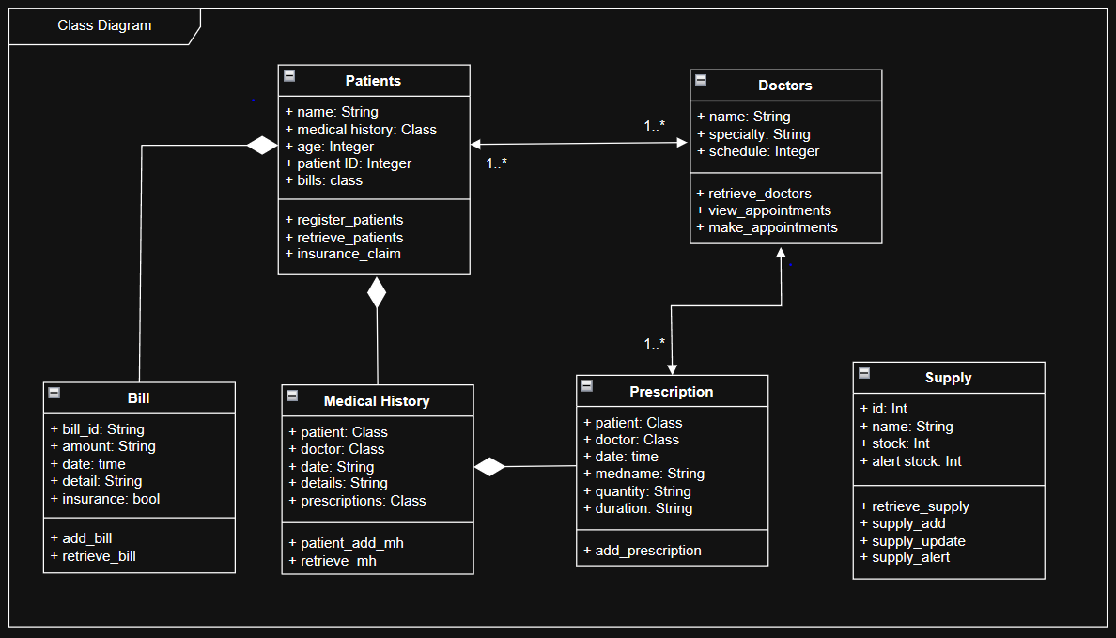
Class UML

Slide 5
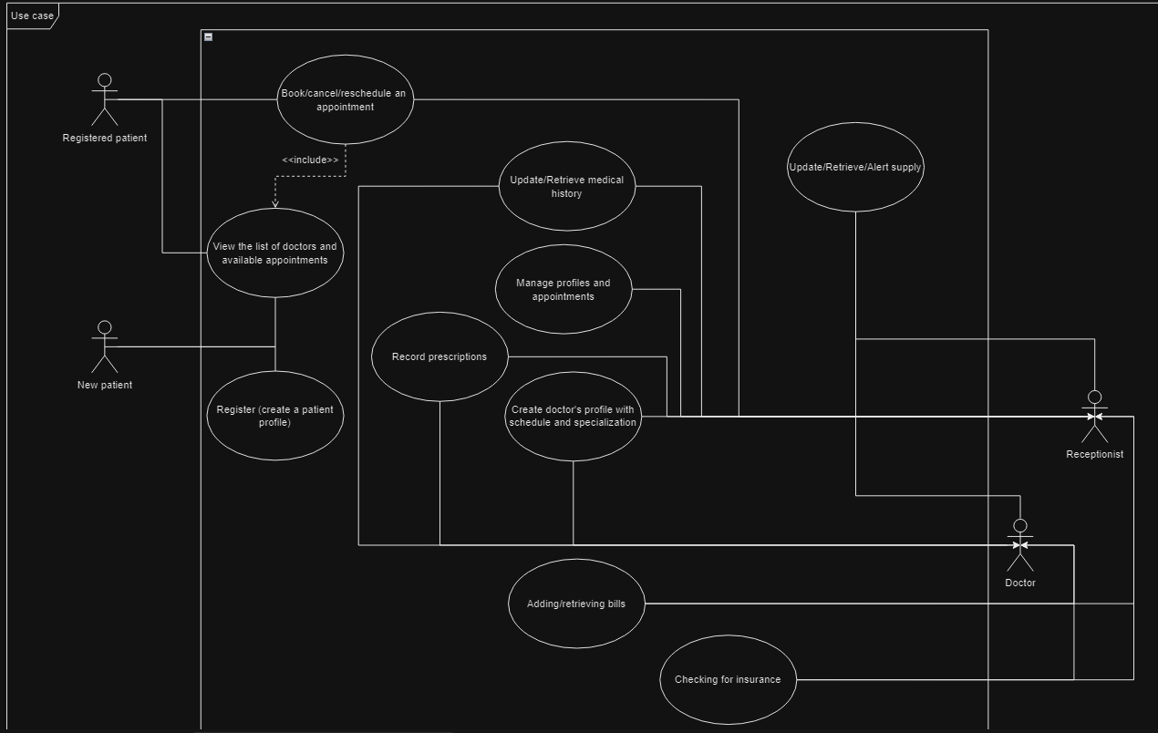
Use case UML

Slide 6
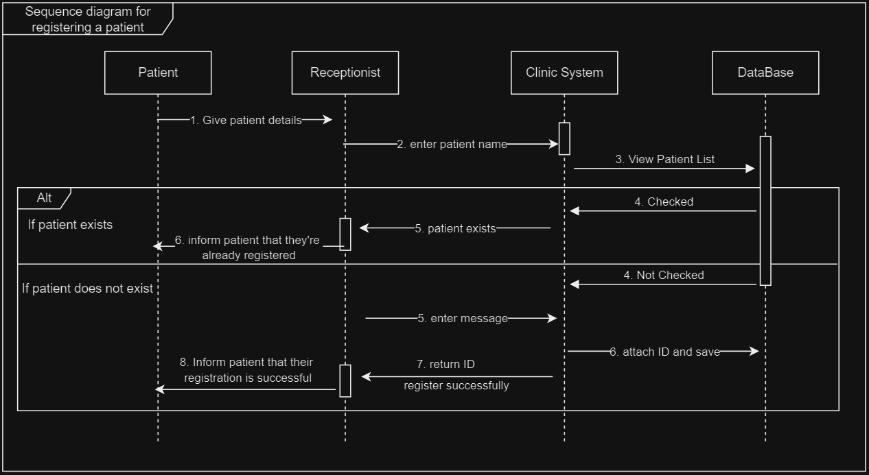
Sequence UML for registering a patient

Slide 7
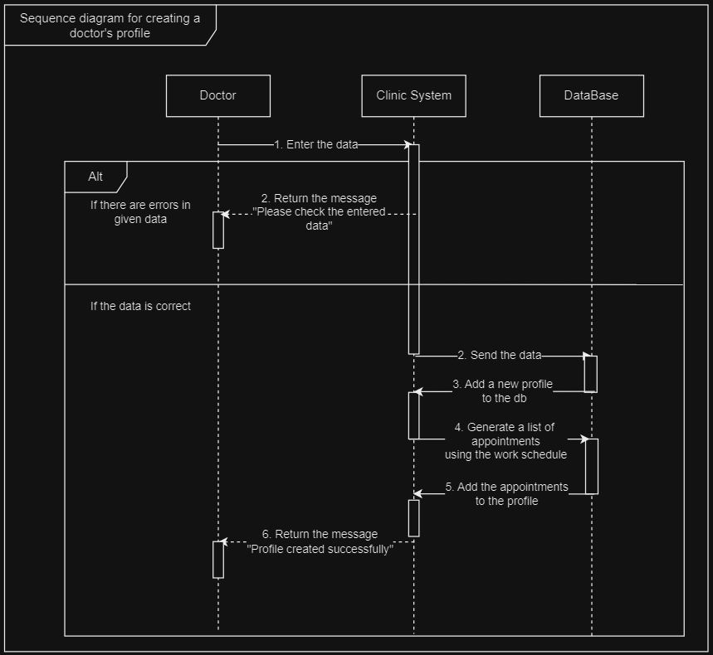
Sequence UML for creating a doctor's profile

Slide 8
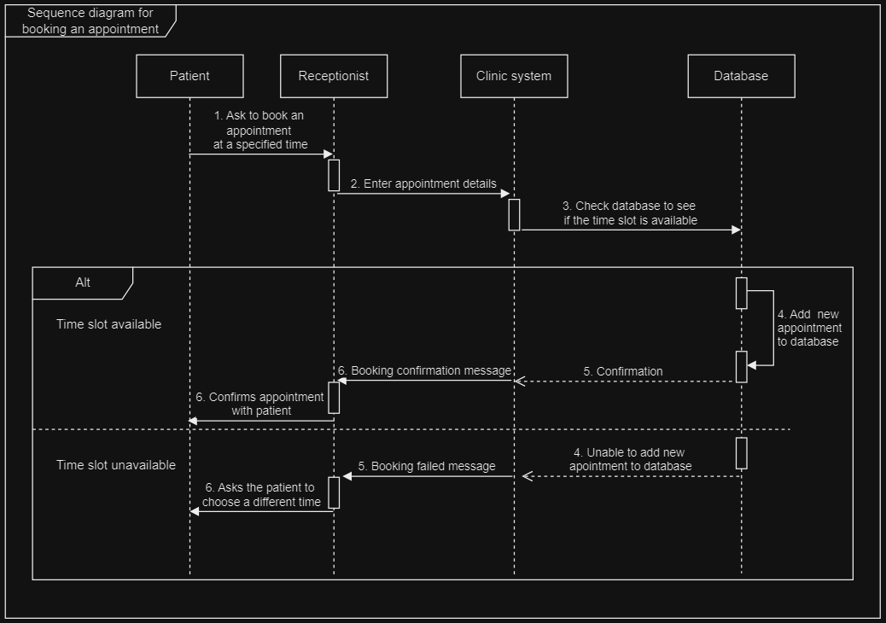
Sequence UML for booking an appointment

Slide 9
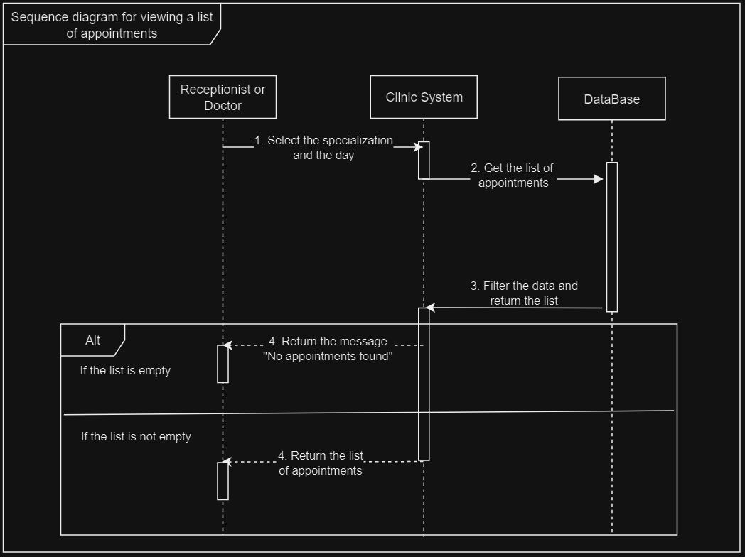
Sequence UML for viewing appointment list

Slide 10
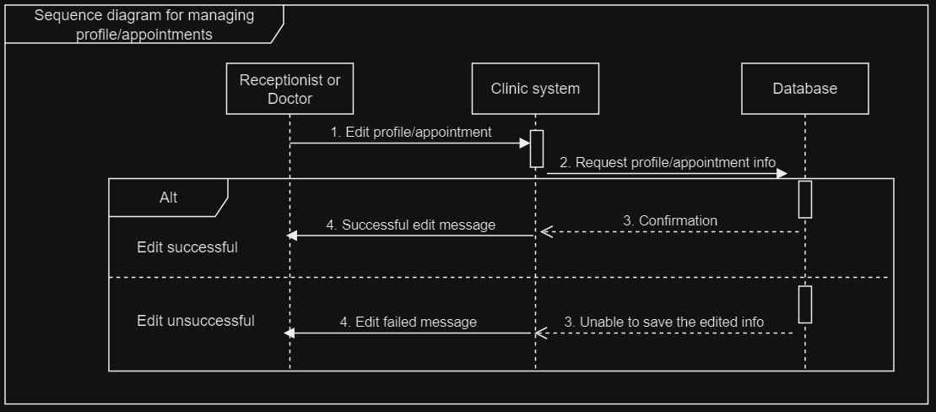
Sequence UML for managing appointments and profiles

Slide 11
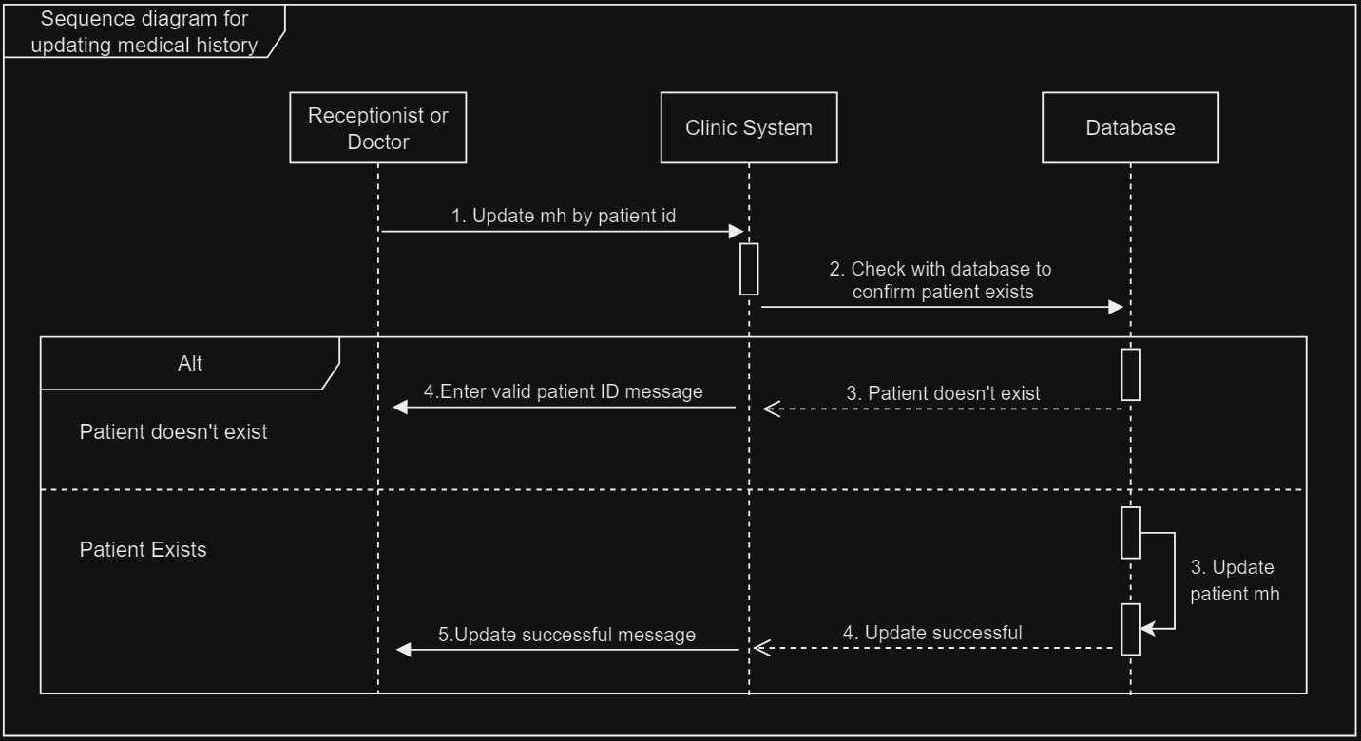
Sequence UML for updating medical history

Slide 12
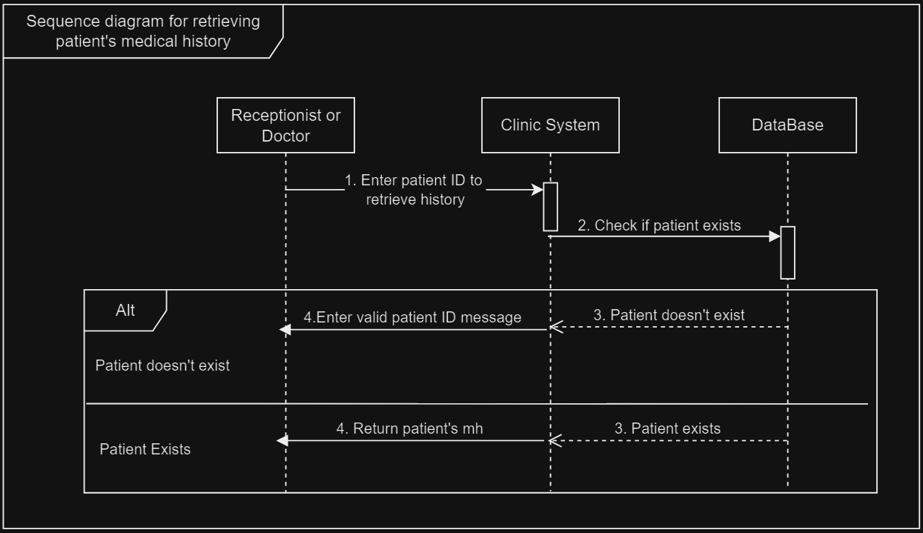
Sequence UML for retrieving medical history

Slide 13
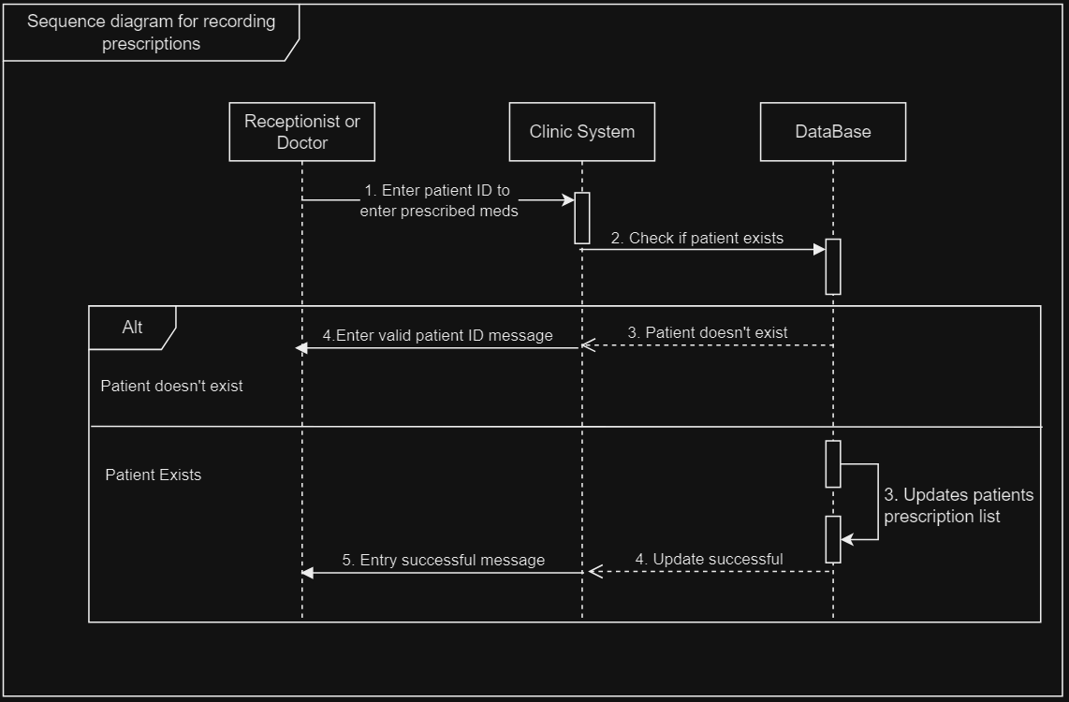
Sequence UML for recording prescriptions

Slide 14
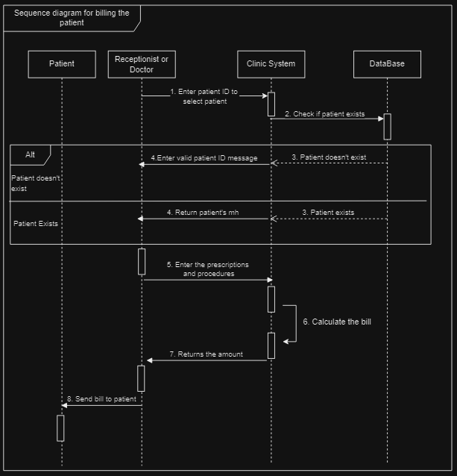
Sequence diagram for billing the patient

Slide 15
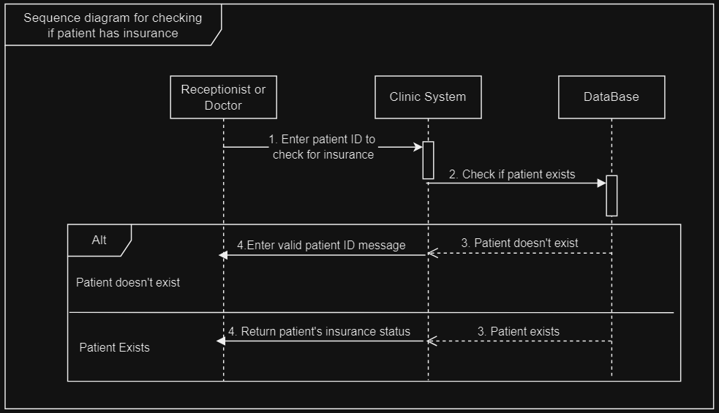
Sequence diagram for checking patient's insurance

Slide 16
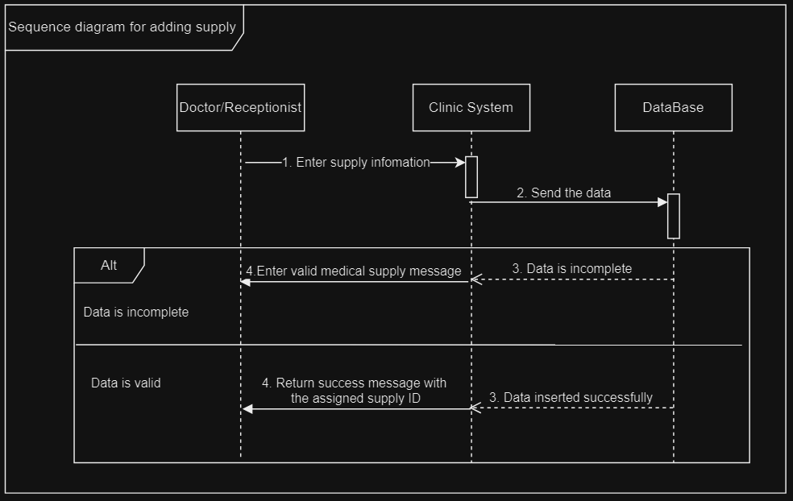
Sequence diagram for adding supply

Slide 17
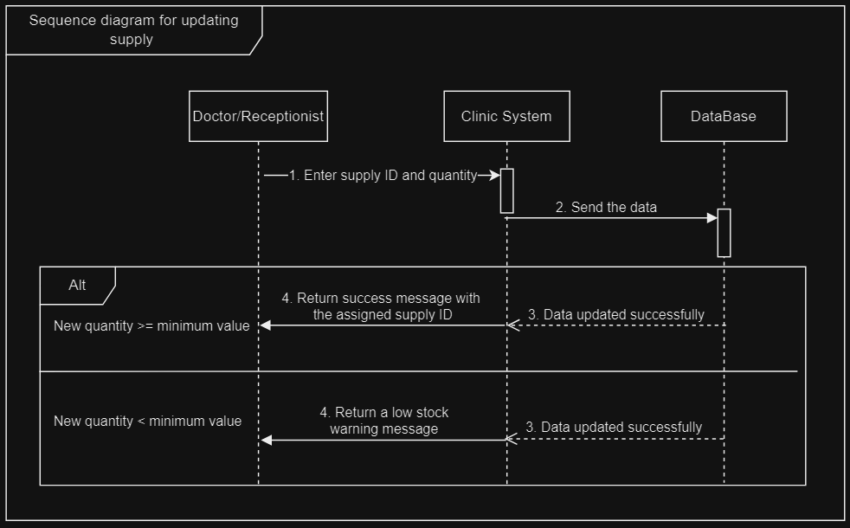
Sequence diagram for updating supply

Slide 18
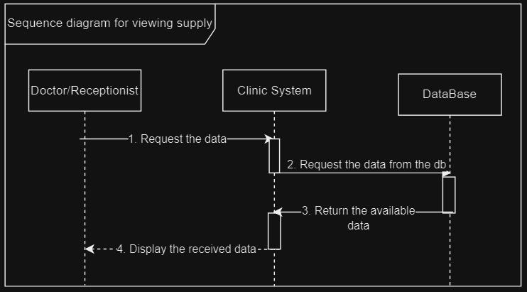
Sequence diagram for viewing supply

